Slide 1

LUNG DISEASE DETECTION
A SHORT OVERVIEW

Slide 2


INTRODUCTION
The aim of our project is to detect lung diseases from chest X-rays using computer vision and ML...The diseases that contain in our datasets are Bacterial & Viral Pneumonia, COVID-19, Tuberculosis. The importance is to Helps doctors diagnose faster, especially in rural areas.

Slide 3
MOTIVATION
Lung diseases are still widespread and deadly if not detected early.
1
This helps doctors make faster decisions and can potentially save lives.
2
Many people in rural or remote areas don’t have access to expert doctors or radiologists.Because of that, diseases like pneumonia, COVID-19, and TB may not be diagnosed in time.So, we created a system that can automatically detect these diseases from chest X-rays using machine learning
3

Slide 4
DATASET
Lung Disease Chest X-ray Dataset
Classes: Normal, Bacterial Pneumonia, Viral Pneumonia, COVID-19, TB
Image Format: JPG/PNG, resized to 128x128, grayscale
Structure: train/ and test/ folders

Slide 5
METHODOLOGY
The system was developed using image processing and machine learning techniques to classify chest X-ray images into different lung disease categories. The steps involved are as follows:
1) Image Preprocessing: Grayscale, histogram equalization, resize
2)Feature Extraction: Histogram of Oriented Gradients (HOG)
3)Model Training: Support Vector Machine (SVM - linear & RBF),RFC,KNN
4)Evaluation: Accuracy, confusion matrix, classification report

Slide 6
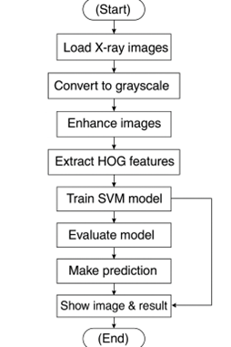
ARCHITECTURE DIAGRAM

Slide 7
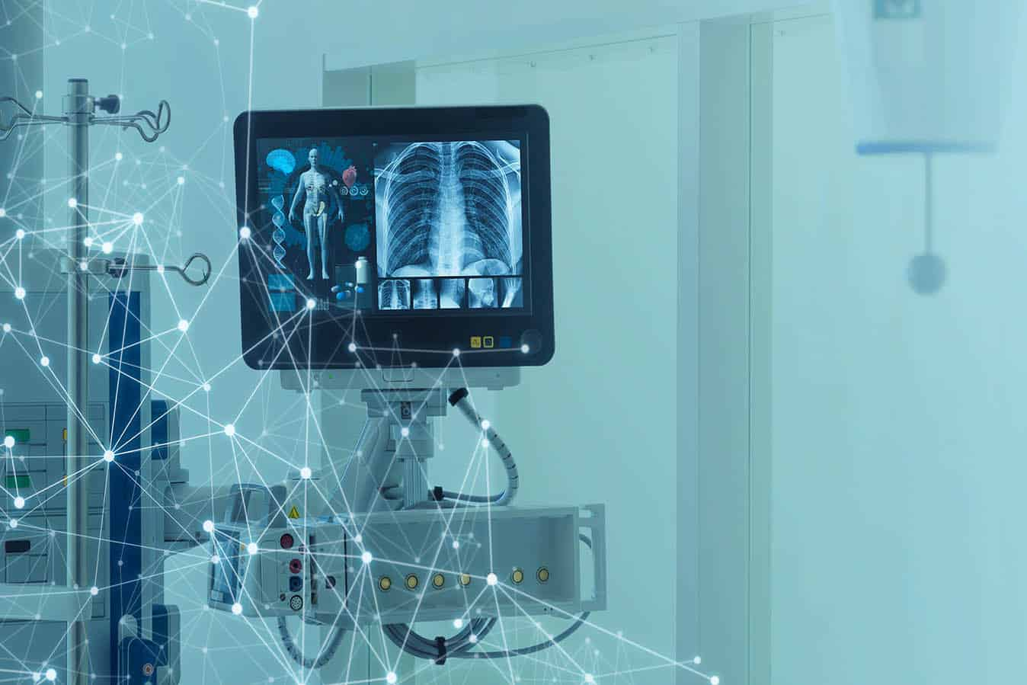
STREAMLIT WEB APP
Developed a user-friendly web app for real-time testing
Upload chest X-ray & choose model (SVM, RFC, KNN)
Displays prediction with confidence score
No technical skills required to use

Slide 8
RESULTS
SVM (RBF): 79.90% accuracy
SVM (Linear): 75.51%
Random Forest: 72.49%
KNN: 63.80%
SVM (RBF) best captures complex patterns in X-rays

Slide 9
CONCLUSION
BUILT AN EFFECTIVE LUNG DISEASE DETECTION SYSTEM USING MACHINE LEARNING.
High performance with SVM RBF model.
Can assist healthcare in fast and accurate diagnosis.
Potential for real-time or rural healthcare deployment.

Slide 10
THANK YOU

